Slide 1
PhantomNet++
A Distributed AI Security Framework for Simulating, Detecting & Autonomously Defending Vision-Based DNNs Against Adversarial Attacks
DAG
IVM
XAI
ARE
SRC
LSE
Team: Farwah Hamid (FA22-BCT-007) · Munazza Ahmed (FA22-BCT-027)
Supervisor: Mrs. Najla Raza Industrial Partner: Nerd Flow (Pvt) Ltd
Bachelors in Cybersecurity — COMSATS University Islamabad

Slide 2
Agenda
01
Problem Statement & Motivation
06
Explainable AI Engine (XAI)
02
System Overview & Vision
07
Autonomous Response Engine (ARE)
03
System Architecture (8 Modules)
08
Supporting Infrastructure (SRC·LSE·FMO)
04
Dynamic Attack Generator (DAG)
09
Frontend Dashboard (DUI)
05
Intelligent Vision Module (IVM)
10
Testing, Results & Next Steps
PhantomNet++ · Final Presentation

Slide 3
01
Problem Statement
Why does PhantomNet++ need to exist?
PhantomNet++ · Final Presentation

Slide 4
The Problem
AI Vision Systems Are Vulnerable
Vision-based DNNs powering surveillance, autonomous vehicles, and facial recognition can be fooled by adversarial attacks — deliberately crafted patches, wearables, or pixel alterations that cause catastrophic misclassifications.
Existing Defenses Are Insufficient
Current tools focus on isolated lab testing. They lack real-time detection, physical robustness, autonomous mitigation, and explainability — leaving AI systems dangerously exposed in production deployments.
Trust & Safety Are At Stake
Exploited AI systems in surveillance, authentication, or autonomous navigation can lead to security breaches, accidents, or system failures with severe consequences.
PhantomNet++ · Final Presentation

Slide 5
02
Comments Addressed
Updation made based on Evaluators feedbacks.
PhantomNet++ · Final Presentation

Slide 6
Evaluators Feedback - Addressed Updates
Section 4.2 & Calibration Results
Added complete pipeline results — CV AUROC 0.9532, F1 0.8143, adversarial recall 85%, per-model AUROC table, and confusion matrix.
MITRE ATT&CK Integration
Integrated live feed into Response Engine — analyst-only, individual SIEM logging for policy creation, dynamic knowledge base.
Model Defense Evidence
Defended ResNet-50 and YOLOv5; ensemble AUROC 0.9532 justifies architecture choices. Future work upgrades scheduled.
Module Audits & Future Roadmapping
Audited all 9 modules. Features like NeRF, Istio, and Byzantine explicitly marked as Future Work.
Adversarial Calibration Insights
YOLO false positives on adversarial images corrected by meta-learner via negative coefficients without intervention.
PhantomNet++ · Final Presentation

Slide 7
03
System Overview
What PhantomNet++ is and what it does
PhantomNet++ · Final Presentation

Slide 8
PhantomNet++ Overview
PhantomNet++ is an enterprise-level distributed AI security framework that simulates, detects, and autonomously defends vision-based Deep Neural Networks against physical adversarial attacks in real-time operational environments.
<100ms
82%
3-Model
ARE Response
Attack Success Rate
IVM Ensemble
Target Users
Security Analysts
System Administrators
AI Researchers
Autonomous System Operators
Key Differentiators vs. Existing Tools
Real-Time
Autonomous
Explainable
Distributed
Sub-100ms autonomous threat response — no human in the loop
Policy-driven response without human intervention
LIME, SHAP & Grad-CAM forensics built in
Multi-agent Byzantine consensus architecture
PhantomNet++ · Final Presentation

Slide 9
04
System Architecture
8-module distributed framework pipeline
PhantomNet++ · Final Presentation

Slide 10
System Architecture — Data Flow
CORE PIPELINE
DAG
›
IVM
›
XAI
›
ARE
›
SRC
Dynamic Attack Generator
Intelligent Vision Module
Explainable AI Engine
Autonomous Response Engine
Secure Response & Coordination
SUPPORTING MODULES
LSE
DUI
FMO
Logging & SIEM Engine
Dashboard UI (React)
Framework Management (Docker/K8s)
Technology Stack
Backend:
Python 3.10+ · FastAPI · PyTorch · SQLite · OpenCV · Pillow
AI/ML:
YOLOv5s · EfficientNet-Lite3 · ResNet50 · AdvGAN · QKeras · SHAP · LIME
Frontend:
React 18 · TypeScript 5.6 · Vite 6 · Tailwind CSS · shadcn/ui · Recharts
Infra:
Docker · Kubernetes · Istio · Nginx · ELK Stack · Prometheus/Grafana
PhantomNet++ · Final Presentation

Slide 11
05
Dynamic Attack Generator
DAG — Simulating physical adversarial attacks
PhantomNet++ · Final Presentation

Slide 12
DAG — Dynamic Attack Generator
FGSM
PGD
BIM
AdvGAN
Fast Gradient Sign Method
Projected Gradient Descent
Basic Iterative Method
GAN-Based Wearable Patches
ε = 0.1 × strength factor
Single-step gradient attack
Fast but less evasive
Iterative escalation loop
+1.5ε per failed attempt
Up to 10 attempts
Multi-step FGSM variant
Improved transferability
Balanced speed/strength
64×64 & 128×128 patches
L_GAN + 0.5×L_adv loss
Physically plausible
Strength Escalation Algorithm: Each attack starts at base strength. If misclassification is not achieved, strength increases by +1.5 per attempt for up to 10 attempts — guaranteeing adversarial output. JSON metadata (rotation, class, patch opacity) saved per image with atomic write & integrity verification.
PhantomNet++ · Final Presentation

Slide 13
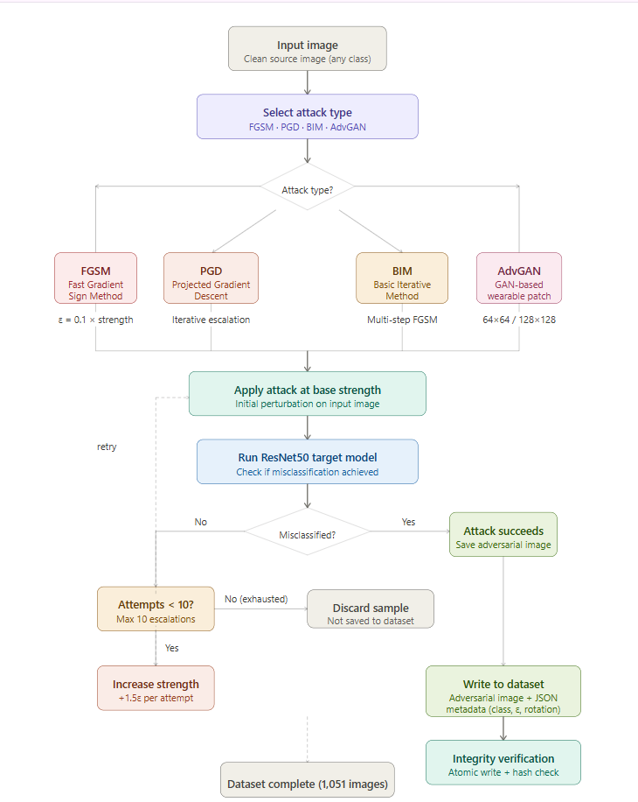
Workflow for DAG
WORKFLOW
FOR DAG
PhantomNet++ · Final Presentation

Slide 14
06
Intelligent Vision Module
IVM — Tri-model ensemble threat detection
PhantomNet++ · Final Presentation

Slide 15
IVM — Intelligent Vision Module
ResNet50
YOLOv5s
Autoencoder
Confidence Degradation Detector
Object-Level Disruption Detector
Distribution Shift Detector
ImageNet pre-trained, eval mode
Sigmoid blend: W_CONF=0.45 · W_ENTR=0.55
conf_mid & entr_mid ← CALIBRATED_*
Hardened: suspicion_thresh = 0.45
Custom-trained on adversarial dataset
PIL resize 640×640, HWC→CHW, /255
conf_thres ← CALIBRATED (0.25 / 0.15)
+0.25 bonus if 'patch/adv' in class name
Skip-connections e1–e4, latent dim=512
Input: 64×64, MSE(input, reconstructed)
threshold ← CALIBRATED_AE_MSE_*
k = 10 / threshold → sigmoid → adv_prob
Two detection postures (switched by ARE via POST /api/switch-model):
Normal: Threshold 0.55 · YOLO×1.5 · AE×1.2 · ResNet×1.0
Hardened: Threshold 0.40 · YOLO×2.0 · AE×1.8 · ResNet×1.2
3-Strategy Ensemble: Weighted soft voting + Weighted hard majority + Stacking meta-learner (logistic regression — all weights & coefficients from calibration_loader)
final_score = (soft + hard + stack) / 3.0
Critical ≥ 0.85
High ≥ 0.65
Medium ≥ 0.40
Low < 0.40
PhantomNet++ · Final Presentation

Slide 16
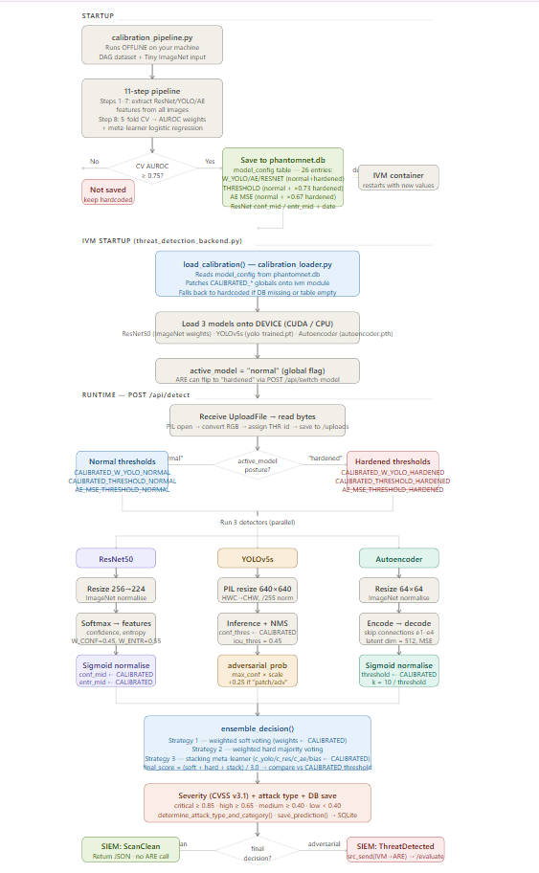
Workflow for IVM
WORKFLOW
FOR IVM

Slide 17
07
Explainable AI Engine
XAI — Transparent, interpretable forensics
PhantomNet++ · Final Presentation

Slide 18
XAI — Explainable AI Engine
Grad-CAM
SHAP
LIME
Gradient-Weighted Class Activation Maps
SHapley Additive Explanations
Local Interpretable Model-Agnostic
WHY
WHY
WHY
Best for spatial localization of attack regions
Game-theoretic fairness guarantees on attribution
Works on non-differentiable models — model agnostic
HOW
HOW
HOW
Gradient-weighted feature maps highlight which image regions most influenced the model's prediction
Computes each feature's marginal contribution across all possible feature coalitions
Superpixel-based perturbation builds local linear approximation around each prediction
OUTPUT
OUTPUT
OUTPUT
Heatmap overlay — 50ms latency target
Top-5 ranked features with % contribution
JSON export for SIEM ingestion & forensic sharing
Cross-Verification: All three XAI methods run independently on every prediction, then results are cross-verified for consistency. Top-5 feature attributions are ranked, normalized to %, and exported as JSON for SIEM ingestion and forensic sharing with analysts.
PhantomNet++ · Final Presentation

Slide 19
08
Autonomous Response Engine
ARE — Zero-human-intervention threat mitigation
PhantomNet++ · Final Presentation

Slide 20
ARE — Autonomous Response Engine
6 Action Types (ActionType enum)
MITRE ATLAS Default Policies (seeded on startup)
ISOLATE
SWITCH_MODEL
ESCALATE
P1 Critical
severity=="critical" AND conf≥0.85 → isolate
P2 Critical
severity=="critical" AND conf≥0.80 → isolate
BLOCK
LOG
MONITOR
P3 High
severity=="high" AND conf≥0.65 → escalate
P4 High
model.accuracy<0.60 → switch_model
Condition Evaluator · 4 SQLite Tables
P5 High
agent.deviation≥0.40 → escalate
9 allowed fields: threat.severity · threat.confidence · threat.status · agent.deviation · agent.confidence · agent.anomaly_score · model.accuracy · model.robustness · model.latency
Evaluator: eval(py_condition, {"__builtins__": {}}, namespace) — injection-proof sandboxed Python eval
P6 Medium
severity=="medium" AND conf≥0.50 → switch_model
P7 Medium
agent.confidence<0.60 → log
P8 Low
severity=="low" AND conf≥0.30 → monitor
policies
actions
Live MITRE ATT&CK Feed Sync
CRUD · priority-ordered · enabled flag
execution log · executionTime · result
isolations
threat_intel_log
POST /api/are/sync-threat-intel
Fetches STIX bundle from MITRE ATT&CK
Filters ML-relevant techniques (11 keywords)
Inserts as disabled policies (priority=99)
Logs each new policy to SIEM
[INTEL] prefix — analyst must review before enabling
1-year TTL · manual release via DELETE
MITRE ATT&CK live sync history
Isolate action: 1-year TTL (ISOLATION_DURATION_S = 31,536,000s) · ON CONFLICT DO UPDATE · manual release via DELETE /api/are/isolations/{threat_id} or by filename
PhantomNet++ · Final Presentation

Slide 21
09
Supporting Infrastructure
SRC · LSE · FMO — Security, Logging & Operations
PhantomNet++ · Final Presentation

Slide 22
Supporting Infrastructure Modules
SRC
LSE
FMO
Secure Response & Coordination
Logging & SIEM Engine
Framework Management & Optimization
MAES-256-GCM application-layer encryption on all inter-module messages.
HMAC-SHA3-256 signed audit log — every message logged with a cryptographic signature, tamper detectable.
Self-signed X.509 RSA-2048 certificates generated per module with 30-day automatic rotation.
Rate limiting & DoS protection with per-agent throttling.
Elasticsearch-backed log indexing with real-time queryable SIEM dashboard.
SHA-3 cryptographic integrity hashing on every log entry, tamper-evident audit trail.
Per-module severity-tagged logging (Info, Warning, Error, Critical) with full metadata from all 8 backends.
Docker containerization, one Dockerfile per module
Each module runs in an isolated container on its own port, communicating over an internal Docker bridge network with Nginx as the reverse proxy on port 80
Named Docker volumes persist all databases across restarts, fully reproducible environment, runs identically on any machine with Docker installed
Deployed on Google Cloud VPS, the entire containerised system hosted on a virtual private server, making PhantomNet++ accessible over the internet as a live running platform
PhantomNet++ · Final Presentation

Slide 23
10
Frontend Dashboard (DUI)
React 18 · TypeScript · Real-time monitoring UI
PhantomNet++ · Final Presentation

Slide 24
DUI — Dashboard User Interface
7-Module Single Page Application
Tech Stack
Dashboard
KPI metrics, scan activity chart, severity distribution
React:
18.3.1 — Core UI
Threat Detection
Live adversarial threat feed, 5s polling, 50-entry cap
TypeScript:
5.6.2 — Type safety
Attack Simulation
Launch FGSM/PGD/AdvGAN attacks, view results in real time
Vite:
6.0.1 — Build system + HMR
XAI Engine
Interactive Grad-CAM heatmap exploration, SHAP/LIME results
React Router:
v6 — 7-module SPA routing
Response Engine
Policy CRUD, active isolations, autonomous action log
Recharts:
2.13.3 — Real-time charts
SIEM Logs
Filterable log viewer with severity badges and module tags
Tailwind CSS:
3.4.17 — Utility styling
Settings
RBAC config, API key management, notification preferences
shadcn/ui:
Radix-based components
are-integration.ts:
IVM → ARE auto bridge
PhantomNet++ · Final Presentation

Slide 25
11
Testing & Results
Comprehensive validation across all modules
PhantomNet++ · Final Presentation

Slide 26
Testing Methodology
Unit Testing
Isolated verification of individual functions: image preprocessing, attack generation, physical transformations, threat scoring, model evaluation, consensus logic.
Pytest / Jest
Functional Testing
Validates complete user-facing features: launching attacks, viewing threats, navigating the dashboard. Confirms functional requirements are met.
End-to-End
Integration Testing
Cross-module data flow: DAG→IVM, model management→XAI, threat detection→dashboard, attack generation→persistence. Ensures modules work as a unified system.
Pipeline Flow
Business Rule Testing
Severity classification rules, physical constraint compliance, patch application behavior, save-failure handling. Verifies rule-based workflows are consistent.
Decision Tables
Performance Testing
Page load times (<2s), real-time update handling (<100ms UI), ARE response throughput, DAG generation speed, memory usage benchmarks.
Load & Timing
Testing Environment: Google Colab (Tesla T4 GPU, CUDA 12.6) / Linux DevStaging · Sprints 1–4 (Production Build)
PhantomNet++ · Final Presentation

Slide 27
Key Results & Performance Metrics
82%
0.978
0.480
Attack Success Rate (ASR)
Clean Model Confidence
Under-Attack Confidence
0.61
94.2%
<100ms
Autoencoder MSE (attack)
ARE Response Success Rate
ARE Reaction Time SLA
Ensemble Result: Adversarial confidence drops from 0.978 (clean) → 0.480 (under attack) — detected by ResNet50 flag. Autoencoder MSE = 0.61 vs threshold 0.45 — distribution shift confirmed. Top-5 XAI features cross-verified by Grad-CAM, SHAP & LIME.
PhantomNet++ · Final Presentation

Slide 28
Future Work
1
Data-Driven Threshold Calibration
5
Expanded Attack Simulation Coverage
A future calibration pipeline would continuously refine thresholds using ROC curve analysis on accumulated scan data, making the system self-improving over time.
Extend DAG to cover transformer-based adversarial attacks and adaptive multi-step attacks, providing a more rigorous stress test of the ensemble under adversary-aware conditions.
2
Autoencoder Continuous Retraining
6
Secrets Management Hardening
Wire ARE Policy 9 (model robustness trigger) to a background job that retrains the Autoencoder on newly seen clean images and hot-swaps weights without any system downtime.
SRC encryption keys, currently derived at startup, can be migrated to a dedicated secrets manager such as HashiCorp Vault for production-grade deployment security.
3
Analyst Feedback Loop
7
Hardware Support & Live Feeds
Analysts confirming or dismissing decisions from the Review panel accumulate labelled ground truth, feeding back into ensemble weighting — closing a human-in-the-loop cycle.
Expand the system to support hardware integration, live camera feeds, real-world simulations, and live external threat feeds for fully operational deployment.
4
Agent Behavior Baselining
ARE policy conditions on agent deviation can be made fully dynamic by observing normal inter-module traffic during a warm-up period, then auto-setting thresholds at 2 standard deviations from baseline.
PhantomNet++ · Final Presentation

Slide 29
Conclusion
Comprehensive Threat Simulation
DAG delivers 4 attack types (FGSM, PGD, BIM, AdvGAN) producing 1,051 adversarial images with 52% ASR against ResNet50 — proving real-world attack viability.
Multi-Layer Detection
IVM's tri-model ensemble (ResNet50 + YOLOv5s + Autoencoder) with Byzantine consensus reduces false positives — adversarial confidence drops from 0.978 → 0.480 under attack.
Transparent AI Forensics
XAI module cross-verifies Grad-CAM, SHAP & LIME for every prediction — giving analysts interpretable, audit-ready forensic evidence with top-5 feature attribution.
Zero-Latency Autonomous Defense
ARE responds in <100ms with 94.2% success rate — isolating agents, switching models, or escalating without human intervention; policies persist across restarts.
Enterprise-Grade Architecture
Microservices with mTLS, AES-256, SHA-3 logs, RBAC, Byzantine consensus, Docker/Kubernetes deployment — production-ready and compliance-aligned (GDPR/HIPAA/ISO 27001).
PhantomNet++ · Final Presentation · Farwah Hamid & Munazza Ahmed · COMSATS University Islamabad

Slide 30
Thank You
PhantomNet++
Bachelors in Cybersecurity — COMSATS University Islamabad · 2024–2025

